Slide 1

101
BURAK EREGAR

Slide 2
101
* What can we do with Kotlin?
* History of Kotlin
* Why Kotlin?
* Is Kotlin Hard?
* Kotlin & Android Studio
* Kotlin's Syntax
* Kotlin's Features
* Anko

Slide 3
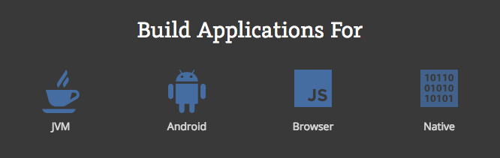

Slide 4
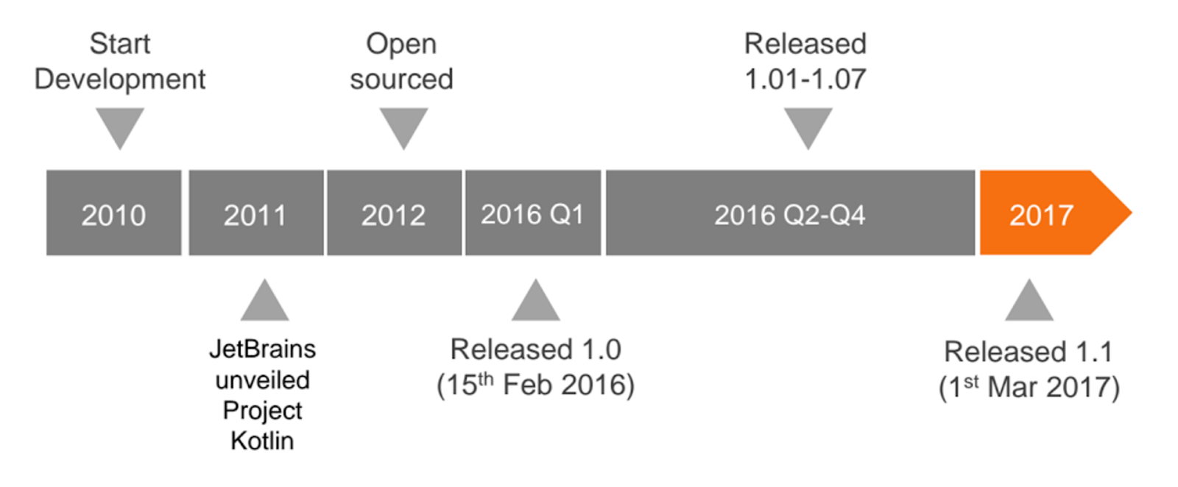

Slide 5
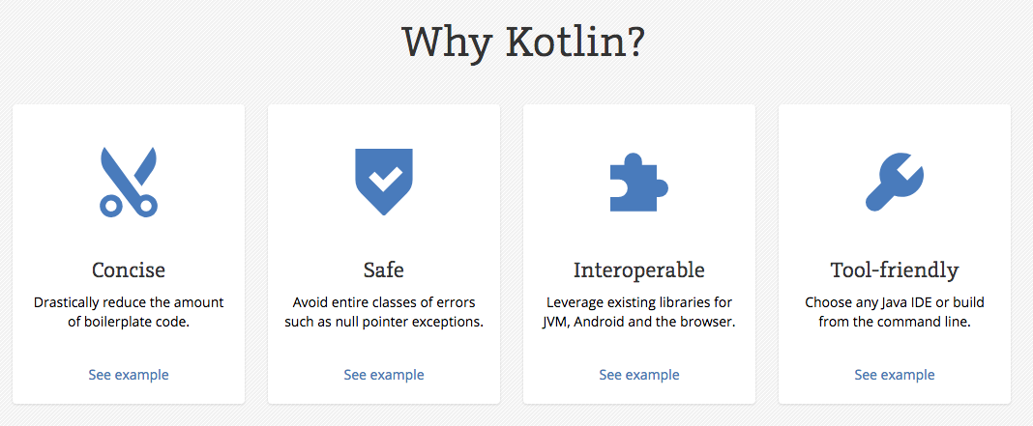

Slide 6
Is Kotlin Hard?
Inspired by Java, C#, JavaScript, Scala and Groovy.
Easy to learn
Start reading and writing in few days
Advanced features can take a little longer but it is not complicated overall

Slide 7
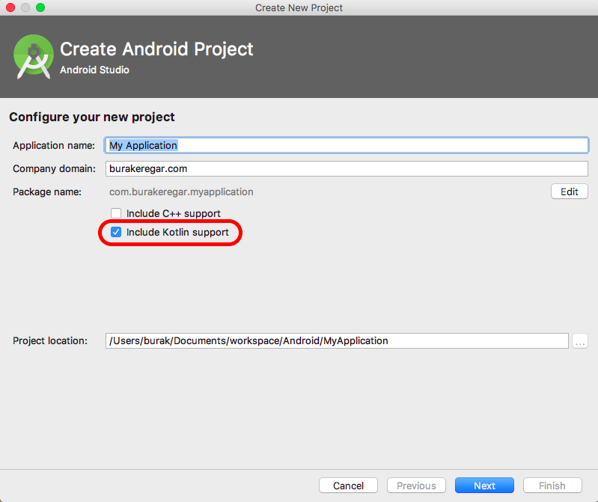
Android Studio Setup

Slide 8
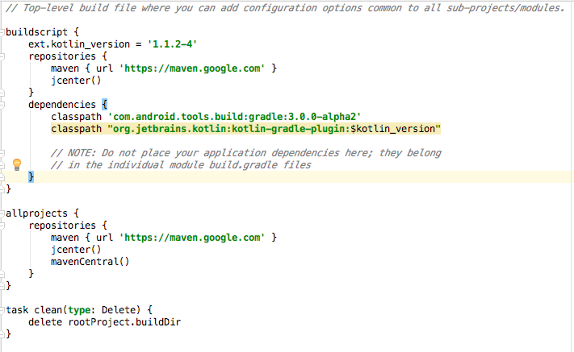
Android Studio Setup

Slide 9
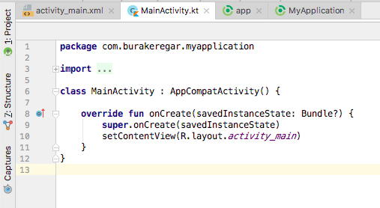

Slide 10
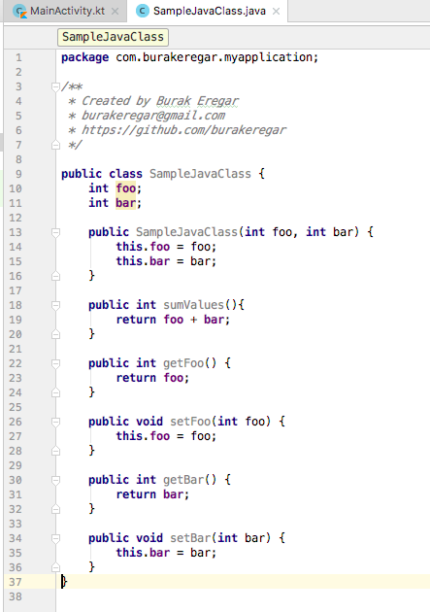

Slide 11
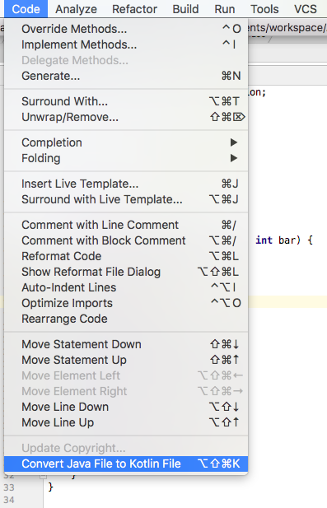

Slide 12
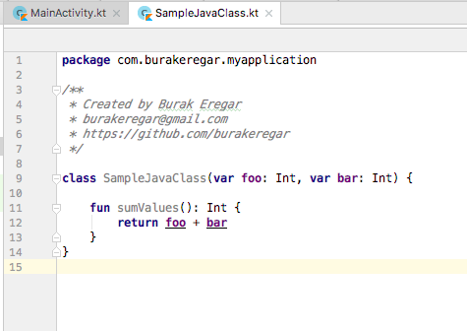

Slide 13
What does it look like?
val x: Int = 1

Slide 14
What does it look like?
Final
val x: Int = 1
Semicolons are optional

Slide 15
What does it look like?
Type is optional
val x: Int = 1

Slide 16
What does it look like?
val x: Int = 1
val y = 1

Slide 17
What does it look like?
val x: Int = 1
val y = 1
normal variable
var z: Int

Slide 18
What does it look like?
var z = ArrayList<Int>()

Slide 19
What does it look like?
No need “new” attribute
var z = ArrayList<Int>()

Slide 20
What does it look like?
Instance of integer ArrayList
var z = ArrayList<Int>()

Slide 21
What does it look like?
void method
fun printSum(x: Int, y: Int) {
print(x + y)
}
fun getSum(x: Int, y: Int) : Int {
return x + y
}
return type

Slide 22
KOTLIN FEATURES

Slide 23
String Templates
val packageName = "com.facebook.katana"
val language = "en"
val googlePlayUrl = "https://play.google.com/store/apps/ details?id=$packageName&hl=$language"

Slide 24
String Templates
val packageName = "com.facebook.katana"
val language = "en"
val googlePlayUrl = “https://play.google.com/store/apps/details?id=$packageName&hl=$language”

Slide 25
Lambdas
button.setOnClickListener(object : View.OnClickListener {
override fun onClick(v: View?) {
//Button click
}
})

Slide 26
Lambdas
Parameter is optional
button.setOnClickListener { view ->
//Button click
}

Slide 27
Lambdas
button.setOnClickListener {
//Button click
}

Slide 28
Data Classes
Just add data
data class User(val name: String, val age: Int)

Slide 29
Data Classes
Just add data
data class User(val name: String, val age: Int)
Getter | Setter
Equals | Hashcode
toString | Copy

Slide 30
Data Classes
Just add data
data class User(val name: String, val age: Int)
Getter | Setter
Equals | Hashcode
toString | Copy
val user = User("Burak", 26)
val olderBurak = user.copy(age = 55)

Slide 31
Singleton
object ThisIsASingleton {
val companyName: String = "JetBrains"
}

Slide 32
Smart Cast
fun demo(x: Any) {
if (x is String) {
} else if (x is Int) {
}
}

Slide 33
Smart Cast
fun demo(x: Any) {
if (x is String) {
print(x.length) // x is automatically cast to String
} else if (x is Int) {
print(x * x) // x is automatically cast to Int
}
}
No need to cast it!

Slide 34
Null Safety & Elvis Operator
class City {
@SerializedName("img")
var image: String? = null
@SerializedName("cityId")
var cityId: Int? = null
@SerializedName("cityName")
var cityName: String? = null
}

Slide 35
Null Safety & Elvis Operator
class City {
@SerializedName("img")
var image: String? = null
@SerializedName("cityId")
var cityId: Int? = null
@SerializedName("cityName")
var cityName: String? = null
}
var city = City()
val l = city.cityName?.length ?: 0

Slide 36
Null Safety & Elvis Operator
class City {
@SerializedName("img")
var image: String? = null
@SerializedName("cityId")
var cityId: Int? = null
@SerializedName("cityName")
var cityName: String? = null
}
var city = City()
val l = city.cityName?.length ?: 0
Null check

Slide 37
Null Safety & Elvis Operator
class City {
@SerializedName("img")
var image: String? = null
@SerializedName("cityId")
var cityId: Int? = null
@SerializedName("cityName")
var cityName: String? = null
}
var city = City()
val l = city.cityName?.length ?: 0
Null check
Elvis operator

Slide 38
Lazy Property
Crash! Context required
val policyText = getString(R.string.policy_text)
override fun onCreate(savedInstanceState: Bundle?) {
super.onCreate(savedInstanceState)
print(policyText)
}

Slide 39
Lazy Property
Won’t be executed, until first call
val policyText by lazy { getString(R.string.policy_text) }
override fun onCreate(savedInstanceState: Bundle?) {
super.onCreate(savedInstanceState)
print(policyText)
}

Slide 40
Extension Functions
Extensions.kt
fun ImageView.loadImageFromUrl(url: String) {
Picasso.with(context).load(url).into(this)
}

Slide 41
Extension Functions
Extensions.kt
fun ImageView.loadImageFromUrl(url: String) {
Picasso.with(context).load(url).into(this)
}
YourActivity.kt
imageView?.loadImageFromUrl(“http://…image.png”)

Slide 42
Shorten Functions
fun getSum(x: Int, y: Int) : Int {
return x + y
}

Slide 43
Shorten Functions
fun getSum(x: Int, y: Int) : Int {
return x + y
}
Redundant

Slide 44
Shorten Functions
KOTLINIZED!
fun getSum(x: Int, y: Int) = x + y

Slide 45
Inline Functions
inline fun doSomething(f : () -> Any){
println("Doing something with the function")
f()
println("Done!");
}
fun main(args : Array<String>){
doSomething {
println("I'm in the function now!")
}
}
// OUTPUT:
// Doing something with the function
// I'm in the function now!
// Done!

Slide 46
Let
fun showStrings(model: ComplexModel?) {
showString(model?.innerModel?.innerModel2?.address?.street)
showString(model?.innerModel?.innerModel2?.address?.zipCode)
showString(model?.innerModel?.innerModel2?.address?.district)
showString(model?.innerModel?.innerModel2?.address?.city)
}

Slide 47
Let
fun showStrings(model: ComplexModel?) {
model?.innerModel?.innerModel2?.address?.let {
showString(it.streetName)
showString(it.zipCode)
showString(it.district)
showString(it.city)
}
}
KOTLINIZED!

Slide 48
With
recyclerView.setHasFixedSize(true)
recyclerView.addItemDecoration(createDecorator())
recyclerView.layoutManager = LinearLayoutManager(applicationContext)
recyclerView.adapter = myAdapter

Slide 49
With
with(recyclerView){
recyclerView.setHasFixedSize(true)
recyclerView.addItemDecoration(createDecorator())
recyclerView.layoutManager = LinearLayoutManager(applicationContext)
recyclerView.adapter = myAdapter
}
Redundant

Slide 50
With
with(recyclerView){
setHasFixedSize(true)
addItemDecoration(createDecorator())
layoutManager = LinearLayoutManager(applicationContext)
adapter = myAdapter
}
KOTLINIZED!

Slide 51
Collections
val numbers: MutableList<Int> = mutableListOf(1, 2, 3)
val readOnlyView: List<Int> = listOf(1, 2, 3)

Slide 52
Collections
mutableListOf(1, null, 2, null, 3, 4, 5, 6, 7, 8, 9)
1,null,2,null,3,4,5,6,7,8,9

Slide 53
Collections
mutableListOf(1, null, 2, null, 3, 4, 5, 6, 7, 8, 9)
.filterNotNull()
1,2,3,4,5,6,7,8,9

Slide 54
Collections
mutableListOf(1, null, 2, null, 3, 4, 5, 6, 7, 8, 9)
.filterNotNull()
.filter { it % 2 == 0 }
2,4,6,8

Slide 55
Collections
mutableListOf(1, null, 2, null, 3, 4, 5, 6, 7, 8, 9)
.filterNotNull()
.filter { it % 2 == 0 }
.sortedDescending()
8,6,4,2

Slide 56
Collections
val list = mutableListOf(1, 2, 3)
if (list.none { it > 6 }) println("No items above 6")
No items above 6

Slide 57
Collections
getOrElse() | groupBy()
find() | map()
filter() | mapNotNull()
filterNot() | all()
filterNotNull() | any()
flatMap() | maxBy()
take() | minBy()
takeLast() | minWith()
sortBy() | sumBy()
sortByDescending() | zip()

Slide 58
Kotlin Android Extension Plugin

Slide 59
Kotlin Android Extension Plugin
apply plugin: 'kotlin-android-extensions'
app.gradle

Slide 60
Kotlin Android Extension Plugin
import xml file
import kotlinx.android.synthetic.main.login_activity.*
class LoginActivity : AppCompatActivity(){
override fun onCreate(savedInstanceState: Bundle?) {
super.onCreate(savedInstanceState)
setContentView(R.layout.login_activity)
}
}

Slide 61
Kotlin Android Extension Plugin
import kotlinx.android.synthetic.main.login_activity.*
class LoginActivity : AppCompatActivity(){
override fun onCreate(savedInstanceState: Bundle?) {
super.onCreate(savedInstanceState)
setContentView(R.layout.login_activity)
loginButton.setOnClickListener {
//do something
}
}
}
loginButton is your button’s id
Get rid of findViewById boilerplate!

Slide 62
Kotlin Android Extension Plugin
import kotlinx.android.synthetic.main.login_activity.*
class LoginActivity : AppCompatActivity(){
override fun onCreate(savedInstanceState: Bundle?) {
super.onCreate(savedInstanceState)
setContentView(R.layout.login_activity)
loginButton.setOnClickListener {
//do something
}
txtTitle.setText(“Login”)
var mailAddress = mail?.text.toString()
var password = password?.text.toString()
}
}

Slide 63
Kotlin Android Extension Plugin
import kotlinx.android.synthetic.main.row_city.view.*
class CityViewHolder(itemView: View?) : GenericViewHolder<Any>(itemView) {
lateinit var item: City
override fun bindData(p0: Any?) {
item = p0 as City
itemView.row_city_name?.setText(item.cityName)
itemView.row_city_root.setOnClickListener{
}
}
}
Add itemView prefix for ViewHolders!

Slide 64
ANKO

Slide 65
Anko
toast("Hi there!")
toast(R.string.message)
longToast("Wow, such a duration”)

Slide 66
Anko
alert("AlertTitle", "AlertText") { positiveButton("Yes") { toast(“You pressed yes”) } negativeButton("No") { toast(“You pressed no”) }
}.show()

Slide 67
Anko
400% faster layouts with Anko
override fun bind(mainActivity: MainActivity): View =
mainActivity.UI {
coordinatorLayout {
fitsSystemWindows = true
appBarLayout {
mainActivity.toolBar = toolbar {
if (Build.VERSION.SDK_INT >= Build.VERSION_CODES.LOLLIPOP) elevation = 4f
}.lparams(width = matchParent, height = actionBarSize())
}.lparams(width = matchParent)
mainActivity.container = frameLayout()
.lparams(width = matchParent, height = matchParent) {
behavior = AppBarLayout.ScrollingViewBehavior()
}
}
}.view

Slide 68



Thanks!
github.com/burakeregar
github.com/burakeregar/KotlinMvpArchitecture
github.com/burakeregar/KotlinMvpTemplateGenerator
burakeregar@gmail.com
Register @ androidistanbul.herokuapp.com
androidistanbul.slack.com #kotlin

